Slide 1
The Bible as Literature: The Hebrew Bible SEN52931 Class Time: Tues & Thurs ABCD 6:25-10:05 Room: 5416

Slide 2
Summer 2016 Bible Lit schedule
Sunday | Monday | Tuesday | Wednesday | Thursday | Friday | Saturday
 |  |  |  | 6/30 | 7/1 | 7/2
 |  |  |  | Class 1
7/3 | 7/4 | 7/5 | 7/6 | 7/7 | 7/8 | 7/9
 | Class 2 |  |  | Class 3
7/10 | 7/11 | 7/12 | 7/13 | 7/14 | 7/15 | 7/16
 |  |  |  | Class 4
7/17 | 7/18 | 7/19 | 7/20 | 7/21 | 7/22 | 7/23
 |  | Class 5 |  | Class 6 |  | Class 7
7/24 | 7/25 | 7/26 | 7/27 | 7/28 | 7/29
 |  | Class 8 Papers due | Final Exam

Slide 3
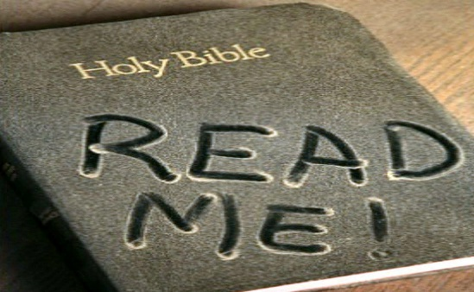
A Literature Class
The most important thing for you to do in this class is to read the assigned reading each week. You can use Chinese to help you understand, but Read in English.
Know the Bible language and stories in English.

Slide 4
The TaNaK (the 3-part Hebrew Bible)
Torah (The Law, Books of Moses, Pentateuch)
Genesis, Exodus, Leviticus, Numbers, Deuteronomy
Nevi’im (The prophets)
The former prophets: Joshua, Judges, 1&2 Samuel, 1&2 Kings
The latter prophets: Isaiah, Jeremiah, Ezekiel, The scroll of the twelve (Amos, Hosea, Micah, Joel, Obadiah, Jonah, Nahum, Habakkuk, Zephaniah, Haggai, Zechariah, Malachi)
Kethuvim (The Writings) (written after exile)
Psalms, Job, Proverbs
Ruth, Song of Songs (Song of Solomon), Ecclesiastes, Lamentations, Esther
Daniel, Ezra-Nehemiah, 1-2 Chronicles

Slide 5
Christian Old Testament
Pentateuch | Historical Books | Poetry and Wisdom | Prophetic Books
Genesis Exodus Leviticus Numbers Deuteronomy | Joshua Judges Ruth 1 Samuel 2 Samuel 1 Kings 2 Kings 1 Chronicles 2 Chronicles Ezra Nehemiah Tobias Judith Esther 1 Macabees 2 Macabees | Job Psalms Proverbs Ecclesiastes Song of Solomon Wisdom of Solomon Sirach | Isaiah Jeremiah Lamentations Baruch Ezekiel Daniel (additions) Hosea Joel Amos Obadiah Jonah Micah Nahum Habakkuk Zephaniah Haggai Zechariah Malachi
Green = Nevi’im (the prophets) Red = Kethuvim (the writings) Yellow = books in the Roman Catholic and Greek Orthodox Old Testament (not in the Hebrew Bible, Tanakh)

Slide 6
The Big Story
God creates/Everything is good
Conflict: Sin leading to death and separation from God.
Action: Attempts to resolve conflict and renew relationship.
The rise and fall and continuation of the Hebrew people is a struggle to renew the relationship.

Slide 7
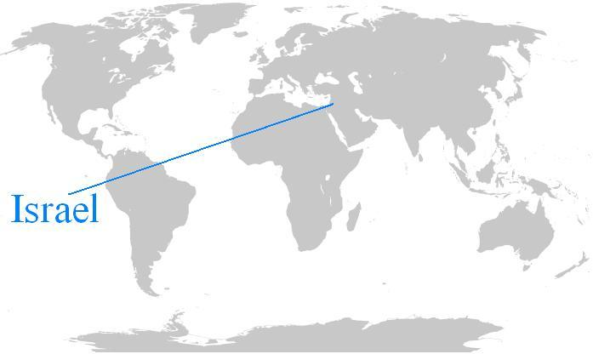
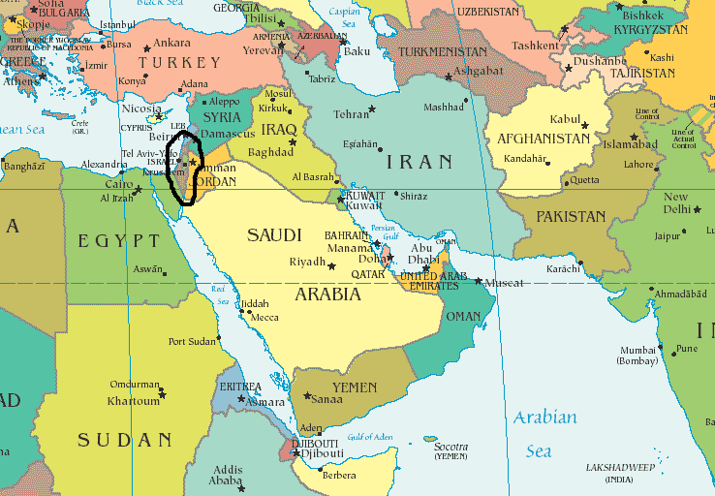
A humble source
A small people group developed one of the most influential narratives in the history of the world.
There is no independent history that records Israel as a very great nation.
Their unified country only lasted for three generations.

Slide 8
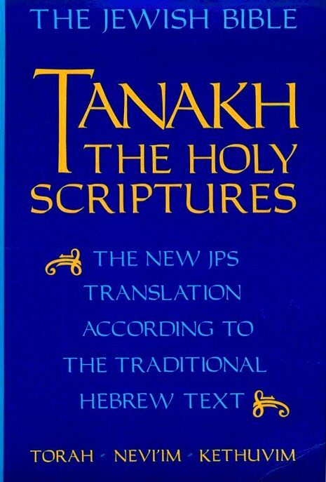

Slide 9
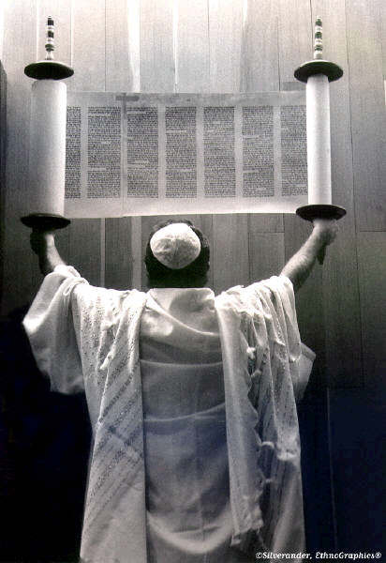
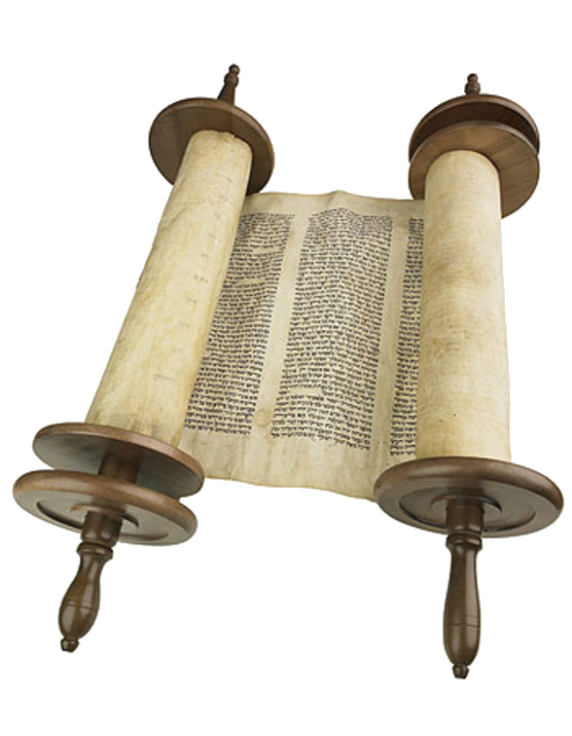

Slide 10
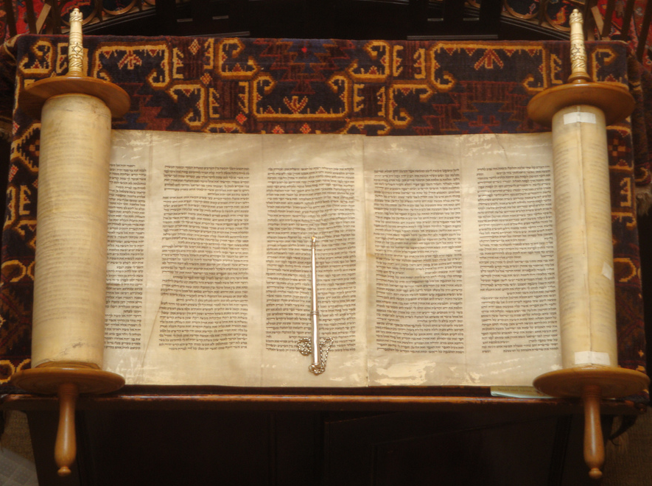

Slide 11
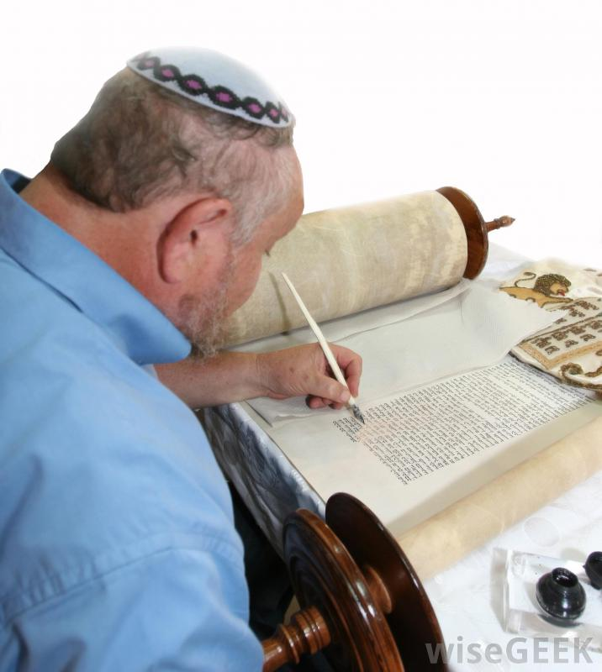

Slide 12
Creation and the Documentary Hypothesis
Genesis 1-3

Slide 13
Documentary hypothesis
The view that the Pentateuch and books immediately following were artfully created by combining a number of older documents into a single, interconnected text.
Scholars have come up with several discernable sources including: P, J, D, and E.
The ancient editors who created finished versions of texts out of earlier materials are called redactors. (like editors, but more complex)

Slide 14
P “Priestly” Source
Scholars think this source was the latest written.
Concerned particularly with religious ritual and the regulation of behavior.
Emphasizes genealogies, formal language, legal codes, ritual.
Opens and closes the Pentateuch.

Slide 15
J “Yahwist” source
Scholars think this is the earliest source
an anthropomorphic view of the deity (God is very much like a human) , whom it calls "Yahweh," (also “Jehovah”) and by its fine storytelling and its earthiness.
Emphasizes important role of women.

Slide 16
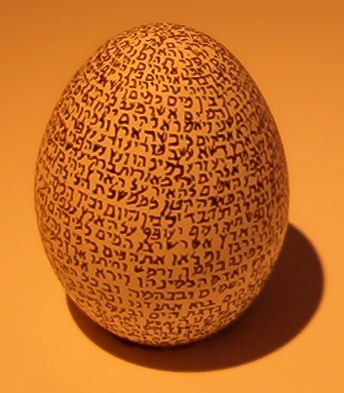
Read Genesis 1 and 2
Note the different versions of the creation story.
Name as many differences as you can.
Especially, note how God is characterized differently.
What are his qualities in each account?
The first chapter of B'reshit, or Genesis, written on an egg in the Israel Museum.

Slide 17
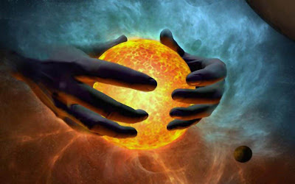

Slide 19
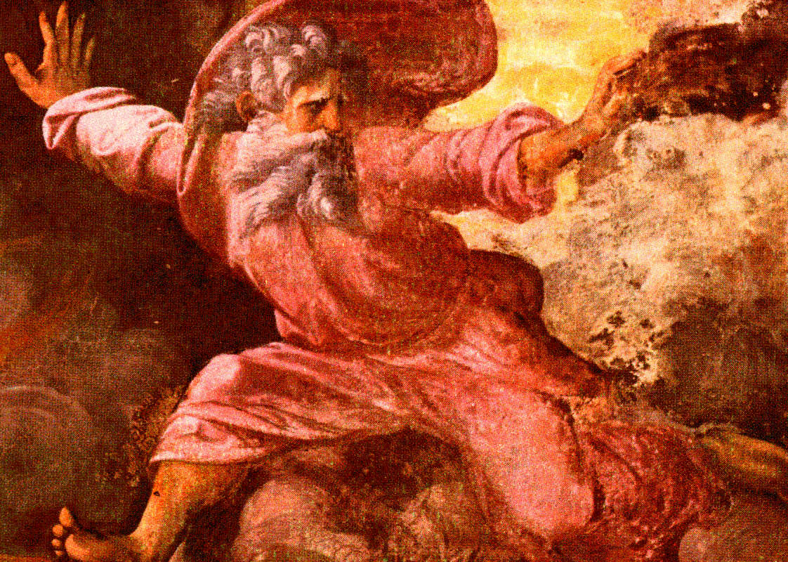
“God separates Light from Darkness” by Raffaello Sanzio Date: 1512, Location: Vatican

Slide 22
Which source: P or J ?
The first creation account?
He’s called “God”
Formal language. Repeated phrases
God speaks everything into existence (only uses words)
Step by step
God blesses man (& gives him plant life for food)
The second creation account?
He’s called “the Lord God”
God has more human qualities: forms man, breathes life, plants garden, puts man in garden, brings woman
God gives man rules.

Slide 23
The First Account: Gen. 1-2:3
Creation Day 1 (1:1-5): The heavens and the earth. God then speaks light into existence. He separates the light from the dark and names the light “day” and the dark “night.” Creation Day 2 (1:6-8): God creates the sky. The sky forms a barrier between water upon the surface and the moisture in the air. Creation Day 3 (1:9-13): God creates dry land and separates it from the seas. God creates self-sustaining plant life both large and small. Creation Day 4 (1:14-19): God creates all the stars and heavenly bodies, the sun and the moon. Dark and light are separated, Is this the creation of time? Creation Day 5 (1:20-23): God creates all life that lives in the water. God also makes all the birds. The creatures made on Day 5 are the first creatures blessed by God (v. 22). Creation Day 6 (1:24-31): God creates all the creatures that live on dry land, creating man last. Creation Day 7 (2:1-3): God rests. (Does this mean he was weary or just that the creation is complete?). Does this begin the pattern of the work week (six days of work and one of rest?) or has the story been created to explain what was already happening?

Slide 24
The second account: GEN. 2:4-25
2: 4-7: God creates man on the same day that he makes the earth and heavens, before any plants.
2: 8-9: God plants the Garden of Eden
2:10-14: Geography lesson about rivers
2:15-17: Man placed in garden, but don’t eat the fruit.
2:18-20: God creates animal life for Adam’s partnership
2:21-25: Woman created (Gender created?)
Used rib out of man’s side
God brings the woman to the man
Adam speaks poetically
Explains why man leaves parents to be with wife
Naked and not ashamed

Slide 25
Differences in human’s creation
Genesis 1 | Genesis 2
Created on command | Created out of dust
Male and female at once | Male earlier
Last act of creation | Early act of creation
Alive at creation | Breathed life into man
Created in God’s image | Doesn’t mention his image
God blesses them | Tree of life and knowledge of good and evil
“be fruitful and multiply” | Put in the garden to tend it
Fill the earth and subdue it | Don’t eat the forbidden fruit
Have dominion over all life | Woman created out of man
All plant life given to man and animals for food | Naked and not ashamed

Slide 26
Creation of Adam (1510) MICHELANGELO Buonarroti Ceiling of the Sistene Chapel
painting

Slide 27
What are we to know about God?
What does God (what do the writers want us to think that God) dislike?
How does God punish?
What are the effects of God’s punishment?

Slide 28
Gen 3: The Fall: beginning of death & mortality
Talking animals (staple of global folklore)
Serpent not called evil, but “subtle” and “crafty.”
Questions the way God runs things.
It knows what God knows and what people know.
Effects of human disobedience are immediate and deeply painful.
Sexual knowledge is realized as part of sin (loss of innocence).
Line is drawn between the immortal and mortal.
God is still compassionate: makes clothes (first sacrifice; first shedding of blood).

Slide 29
Questions about Adam & Eve
What is the serpent’s talent?
3.6 What three things attracted Eve to the fruit?
Who is active and who is passive during this story? (Who has agency?)
3.5 This verse is said to be a masterpiece of ambiguity and half truth? Why? What is true and not so true about what the serpent said?
3.20 What is significant about the clothes God made for Adam & Eve?
3.22-23 Why are Adam and Eve forced out of the Garden of Eden?

Slide 30
Scenes from the Garden of Eden Jean Dreux 1460

Slide 31
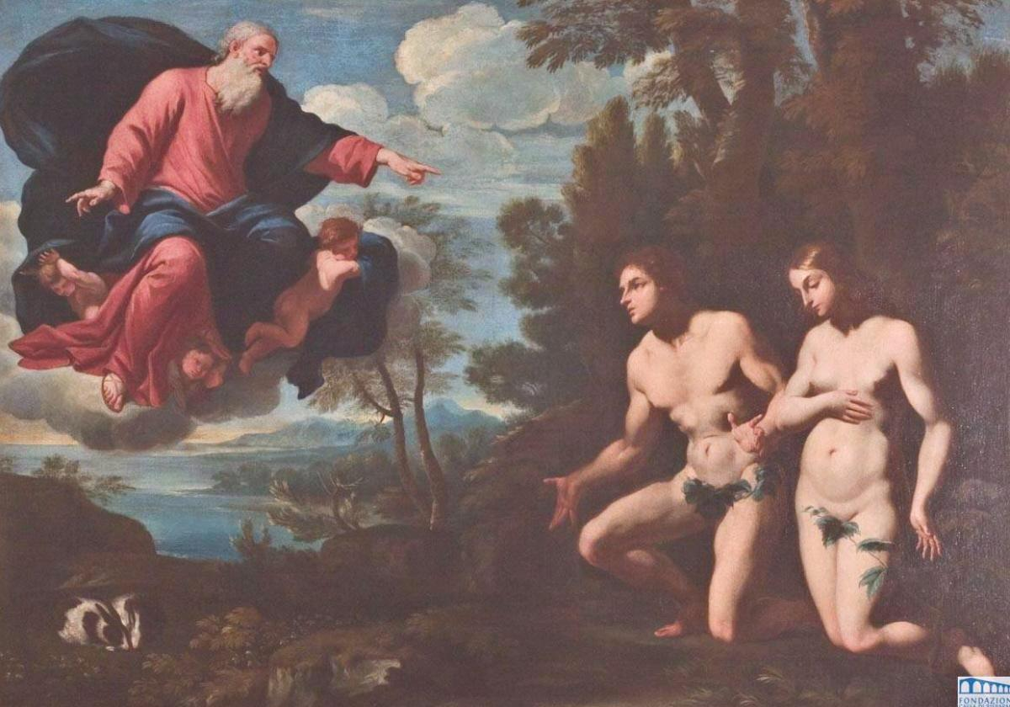
Giacinto Gimignani
“The Expulsion from the Garden of Eden”
17th century

Slide 32
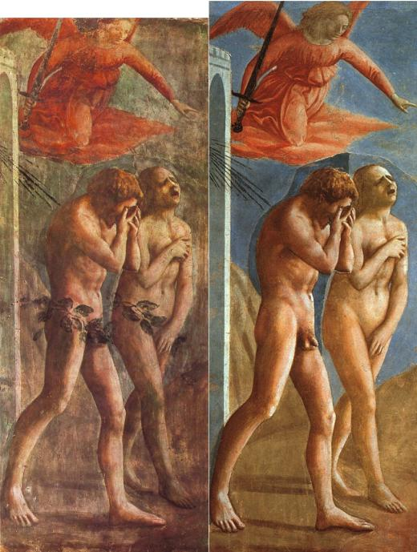
Masaccio
The expulsion of Adam and Eve from the Garden
1426-1428 (altered in 1680, and restored in 1980)

Slide 33
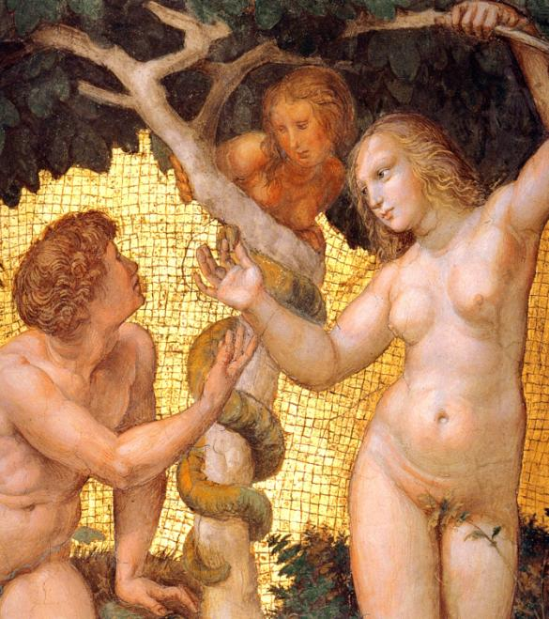
Raphael
Adam and Eve, from the 'Stanza della Segnatura' (detail)
1508

Slide 34
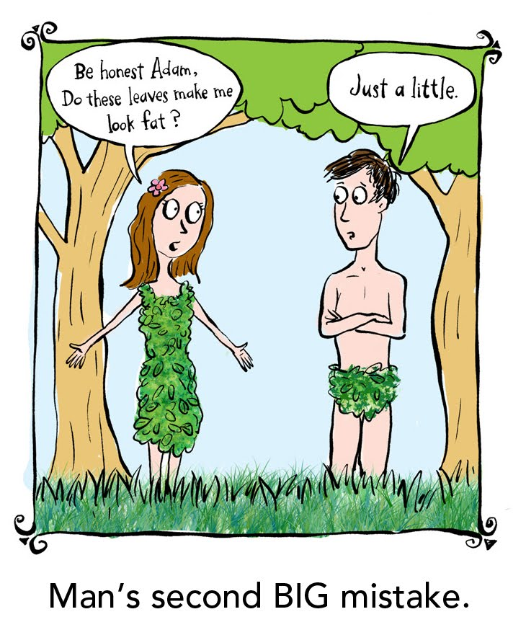

Slide 35
Prehistory (History before the Hebrews)
Genesis 4-11.
What happens repeatedly in almost each of the 4 primeval narratives?
What does the writer want readers to think about God?
Adam & Eve in the Garden (sin enters world)
Cain & Abel (first murder)
Noah (second chance)
Babel (challenging God)
Also look for two distinct narrative strands in the flood story. Who do you think wrote which?

Slide 36
Cycles
Things are good, people are free
People do (choose) evil (transgression)
God punishes
New Start with new conditions a little farther from God.

Slide 37
Cain & Abel: the first murder
Adam “knew” Eve. (knowledge again linked to sexuality) (Gen 4:1)
Cain is produced with the help of Yahweh.
Sibling rivalry (theme resurfaces later).
Cain: “an offering of the fruit of the ground” (Gen 4:3)
Abel: “the firstlings of his flock, the fat portions” (Gen 4:4)
God Prefers Abel’s offering?

Slide 38
Questions about Cain & Abel
Why does God prefer Abel’s offering?
How is God’s reaction to Cain’s sin similar to his reaction to that of Adam & Eve?
How does God treat Cain?
When Cain asks, “Am I my brother’s keeper?” what is the right answer?
How many times is the word “brother” used in chapter 4, verses 8-11?

Slide 39
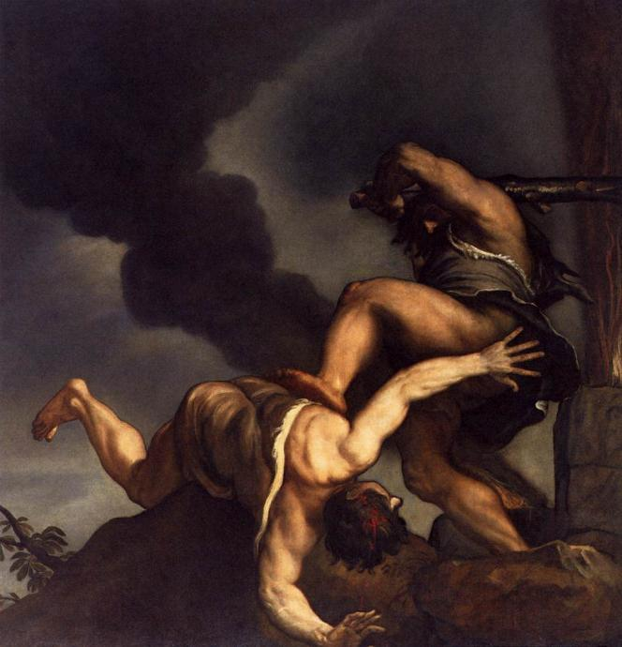
Titian
1542

Slide 40
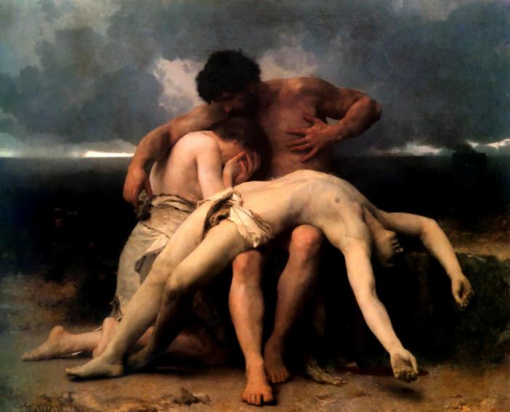

Slide 41
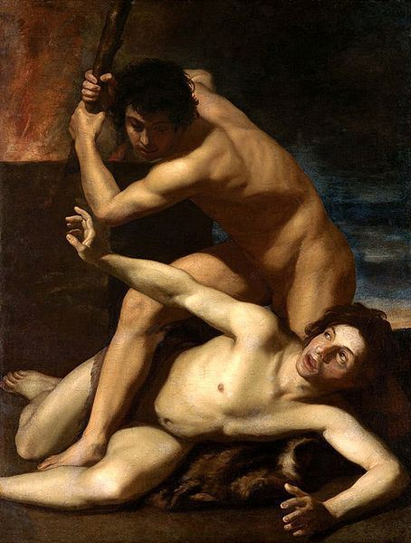
Cain Murdering Abel, circa 1610
By Bartolomeo Manfredi

Slide 42
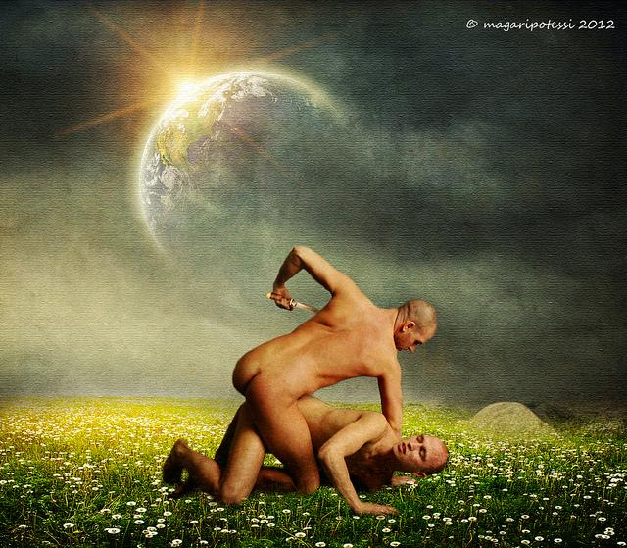

Slide 43
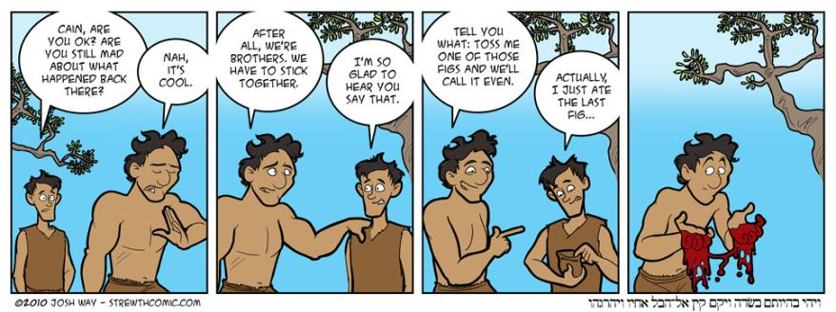

Slide 44
Noah: A new start
Composed of J & P sources interwoven
God expresses profound sorrow (6:5-6)
Earth returns to a pre-creation state when “darkness covered the face of the deep” (1:2)(7:11)
Full of ironies. Full of terror, annihilation, compassion, hope.
Noachan covenant. Rainbow is a symbol. (9: 8-17)
Similar to a story in the older Epic of Gilgamesh.

Slide 45
Questions about the Flood
What are some of the reasons for the flood?
Why was Noah chosen?
What happened after the flood involving his sons?
Do you see this more as a story of annihilation or of a new beginning? (Is this more of a tragedy or story of hope?)

Slide 46
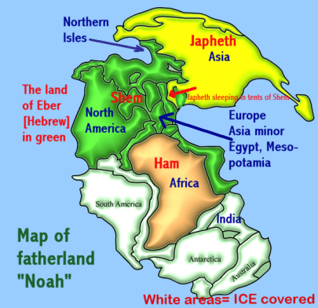
The Sons of Noah disperse and fill the land.

Slide 47
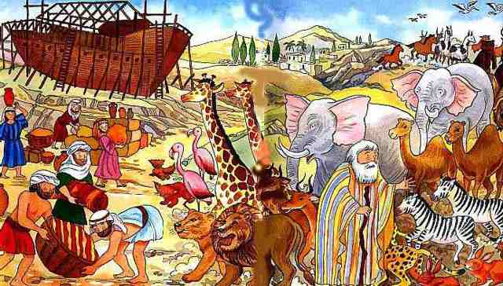
H:\Bible images\Flood\20_colette_isabella_les_animaux_entrent_dans.jpg

Slide 48
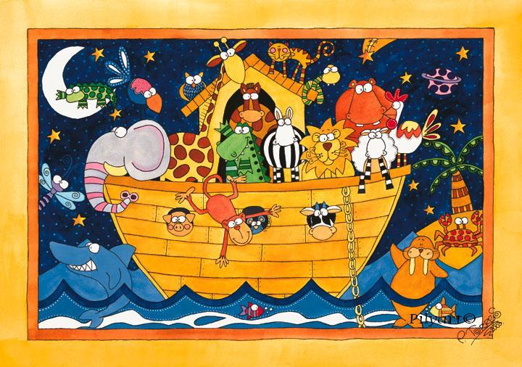

Slide 49
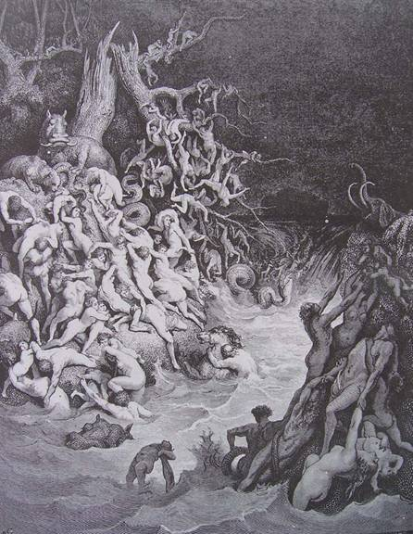
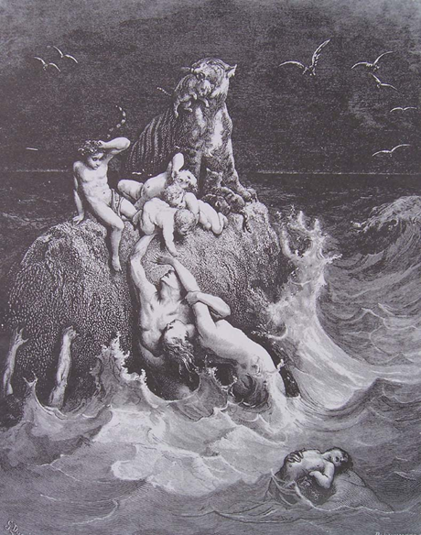

Slide 50
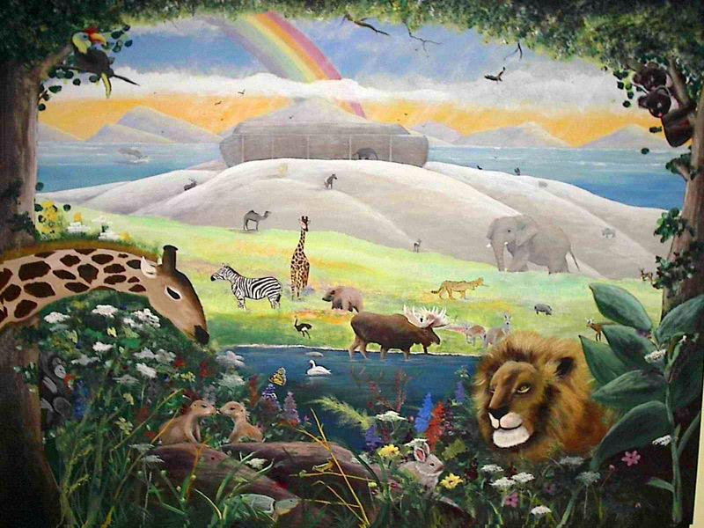
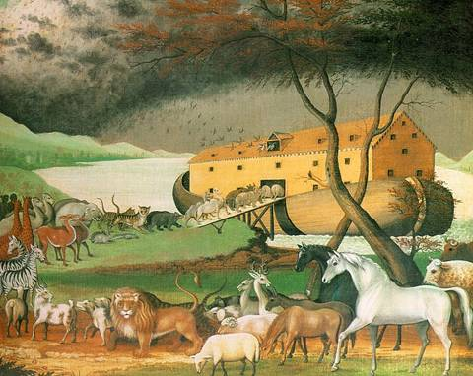

Slide 51
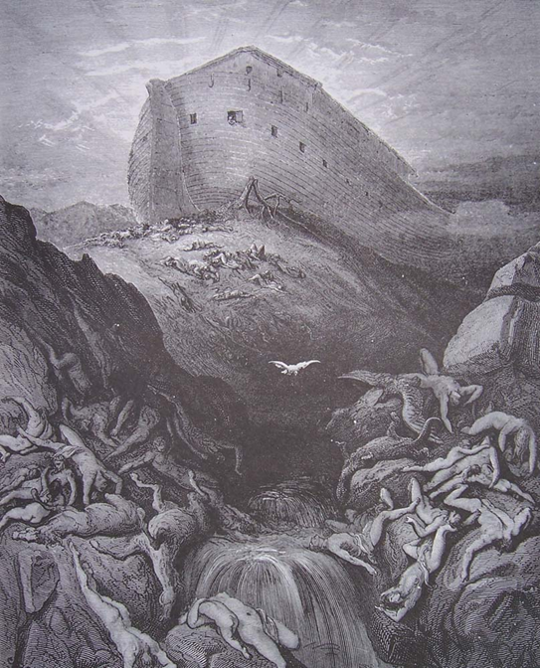

Slide 52
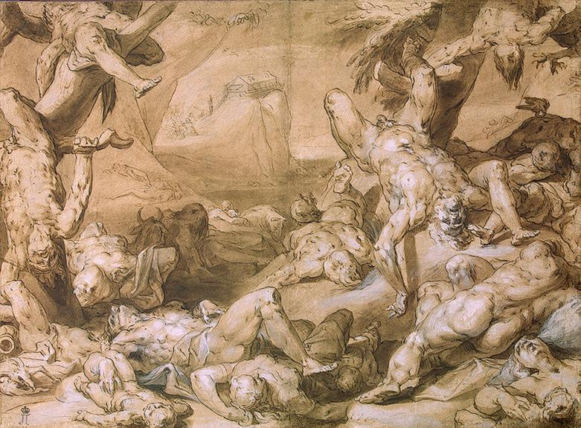

Slide 53
Babel: the last straw
An etiology (story explaining how something originated)
Themes of human ambition and divine retribution
Furthers man’s isolation from the divine

Slide 54
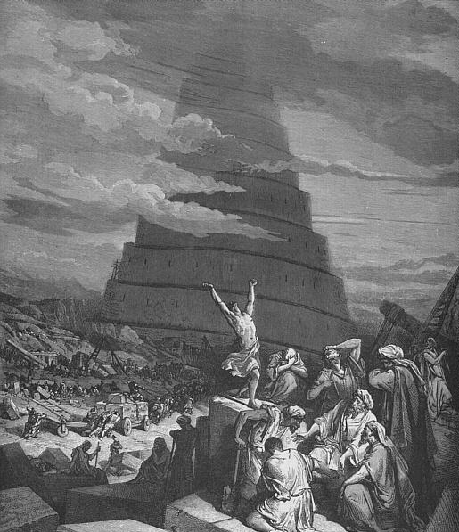

Slide 55
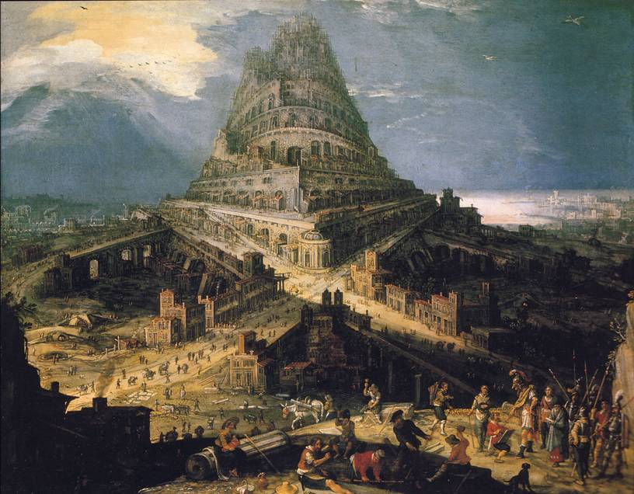

Slide 56
