Slide 1
Part 1: Abraham
The age of the Patriarchs
(The beginning of the Hebrews)
Abraham
Isaac
Jacob (Israel)
Genesis 12-50
Genesis 12-22

Slide 2
Main stories
The Call of Abraham & Covenant (Ch 12, 15, 17, 22)
Patriarch in Trouble over wife (Ch 12:10-20 & 20)
Abraham & Lot (Ch 13-14)
Abram & Lot separate
Abram rescues Lot
Birth of Ishmael (Ch 16)
Circumcision: The sign of the covenant (Ch 17)
Judgment of Sodom & Gomorrah (Ch 18:16-Ch 19)
Birth of Isaac (Ch 21)
The Binding of Isaac (Ch 22)

Slide 3
Questions
What is the covenant between Abraham and God? Put it in your own words?
What is the sign of the covenant?
What is Ishmael’s relationship to the covenant?
How does Abraham screw up twice in the same way?
How does Lot function as a foil for Abraham?
How does the story of Sodom & Gomorrah fit into this narrative?

Slide 4
Lot
He follows Abram (He is Abram’s nephew)
He chooses better land for himself (13:10-11). But not the promised land, and he pays for it.
Rescued by Abram. Opportunity for Abram to shine and be blessed by Melchezedek (14:17-24)
Protects strangers/angels, but offers daughters to be raped.
Is “raped” by his daughters (19:30-38).
He is saved, but doesn’t flourish apart for Abraham.
Sodom & Gomorrah become symbols of depravity.
Lot’s wife becomes symbol of the foolishness of “looking back” on the old life.

Slide 5
The Covenant
12:1-3, 15:5,18, 17:4-8, 22:17-18
Abram’s descendants will become a great nation. (12:2) (15:5) (17:4-7) (22:17)
They will possess a certain portion of land. (12:7) (15:18) (17:8)
All the people of the world will be blessed through them. (12:2 )(22:18)

Slide 6
The Covenant
12: 2-3 The call. Great nation. Bless all families of the earth.
15 first deals with descendants, then with land. Abram shows doubt and belief. Prophecy of 400 years in Egypt.
Verse 6: And he believed the Lord; and the Lord reckoned it to him as righteousness
17 Circumcision as a sign. Abraham doesn’t hesitate. Name change. Ishmael not the child of promise. Isaac is coming. Abraham laughs.
22: 15-18 Covenant reiterated and strengthened. Abraham has proved himself.

Slide 7
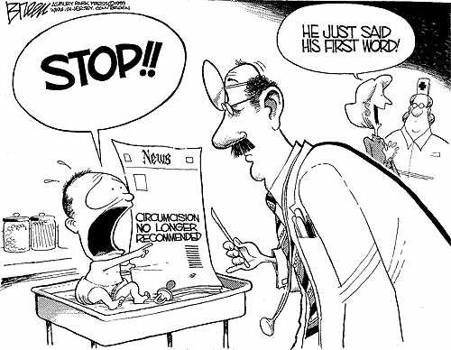
Circumcision
A physical change. Different from others.
Applies only to males
Relates to reproduction, becoming a great nation.
Later references discuss “circumcision of the heart”

Slide 8
Abraham’s travels

Slide 9
The Patriarch in Trouble
Patriarch saying his wife is his sister in order to save himself. God troubles the local king. All parties’ virtue is maintained. Patriarch leaves with more wealth.
12:10-19 (J) In Egypt, Sarai enters Pharoah’s house, God gives plagues, Abe & Sarai leave Egypt with wealth. Foreshadows the Exodus
20 (E) At Gerar. King Abimelech. God controls the whole situation. Given wealth and blessed as they leave.
26:6-11 Isaac & Rebecca. Also in Gerar with King Abimelech.

Slide 10
Hagar & Ishmael
16 It’s Sarai’s idea and Abram passively listens (similar to Eve & Adam situation)
16 (J) Hagar sent away by Sarai when she becomes pregnant (16:5-6). God sees Hagar and offers a portion of the covenant. (16:10)
21:8 (E) Hagar and Ishmael sent away. God sees and saves and makes promise. Abraham more distressed. Anticipates Abraham’s journey with Isaac.

Slide 11
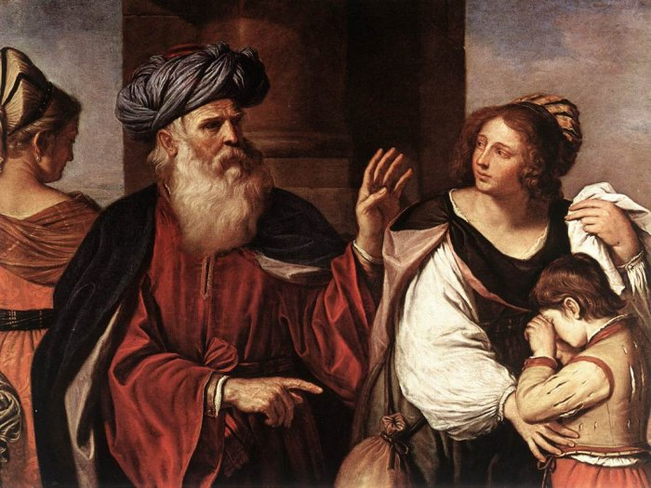
Abraham Casting out Hagar and Ishmael, by Il Guercino
1657

Slide 12
Abraham & Isaac also “The Binding of Isaac” (Gen. 22: 1-19)
Practice of Child sacrifice.
Did Abraham fail? Misunderstood God? He should have rejected proposal right away?
God tested Abraham (22:1)
Did Isaac know?
Bare bones story. Open to lots of interpretation.
Did Moses come down from the mountain alone?

Slide 13
Before the sacrifice

Slide 14
Cigoli -1607

Slide 15
Sarto 1507

Slide 17
Chagall

Slide 18
Rembrandt

Slide 19
Laurent de La Hire - 1650

Slide 20
Highway 61 Revisited by Bob Dylan (1965) play
Arose out of the peace movement of the 1960s.
An angry, anti-authority sentiment.
Bitter, ironic in both word and tone.
Hwy 61 (the “Blues Highway”) follows the Mississippi River.
Bob Dylan’s father’s name is Abraham
Oh God said to Abraham, "Kill me a son" Abe says, "Man, you must be puttin' me on" God say, "No." Abe say, "What?" God say, "You can do what you want Abe, but The next time you see me comin' you better run" Well Abe says, "Where do you want this killin' done?" God says, "Out on Highway 61."

Slide 21
Highway 61 Revisited by Bob Dylan (1965)
Well Georgia Sam he had a bloody nose Welfare Department they wouldn't give him no clothes He asked poor Howard where can I go Howard said there's only one place I know Sam said tell me quick man I got to run Ol' Howard just pointed with his gun And said that way down on Highway 61.
Well Mack the Finger said to Louie the King I got forty red white and blue shoe strings And a thousand telephones that don't ring Do you know where I can get rid of these things And Louie the King said let me think for a minute son And he said yes I think it can be easily done Just take everything down to Highway 61.

Slide 22
Highway 61 Revisited by Bob Dylan (1965)
Now the fifth daughter on the twelfth night Told the first father that things weren't right My complexion she said is much too white He said come here and step into the light he says hmm you're right Let me tell the second mother this has been done But the second mother was with the seventh son And they were both out on Highway 61.
Now the rovin' gambler he was very bored He was tryin' to create a next world war He found a promoter who nearly fell off the floor He said I never engaged in this kind of thing before But yes I think it can be very easily done We'll just put some bleachers out in the sun And have it on Highway 61.

Slide 23
Part 2: Isaac through Joseph
The age of the Patriarchs
(The beginning of the Hebrews)
Abraham
Isaac
Jacob (Israel)
Genesis 12-50
Genesis 23-50

Slide 24
Major stories in this part
Genesis 23-50 (the rest of the book)
Marriage of Isaac & Rebecca
Esau & Jacob
Birth
Selling birthright
Father’s blessing
Jacob’s marriage and prosperity
The rape of Dinah
Joseph
Dreams
sold by brothers
Slavery
Prison
Rise to power
Meets brothers again
Family moves to Egypt

Slide 25
Review
Primeval history (Creation and Fall, Cain & Abel, Noah & Flood, Babel)
Cycle: (1. things are good, 2. people do evil, 3. God punishes, (people remember God) (God remembers them) 4. new start
Writing of the Bible
Documentary hypothesis P & J sources.
It’s subjective. It presents ideas about God.
Call of Abraham (another new start)
Covenant between God & Abraham
Patriarchs
Abraham (tested) (Does he come down the mountain alone? 22:19)
Isaac (Ishmael a threat)
Jacob/Israel (Esau a threat)
12 male children become 12 tribes (Dinah a threat)
Joseph (and brothers)

Slide 26
Dialogism
What’s the difference between a dialogue (conversation) and a speech?
“Impoverishment by univocality” Jacque Derrida
When we try to make a text univocal, “one-voiced,” we take away its richness.
If your goal is “to get the point” then you are impoverishing the text.
The books of the Bible, like all good literature, are dialogic (multivocal), not monologic (univocal).

Slide 27
Danger: threats to the promise
The promise to Abraham depends on lots of descendants who create a new nation, but…
Abraham & Sarah have no children
Promised son to be sacrificed
Isaac can’t have children
Jacob and Esau fight for the promise
Jacob struggles to marry with one he loves (Rachel) & she can’t have children for a long time.
Dinah & threat of intermarriage
Jacob loses favorite son
Famine may wipe them out

Slide 28
The Next three Sons
Abraham (Gen 11-25)
Isaac (Gen 21-27, 35) overshadowed by his father, his wife, and his son.
Jacob (Gen 25-36)
Joseph (Gen 37-50)

Slide 29
Rebekah: What a Woman! (Chs 24-25)
Immediately hospitable to Abraham’s servant (24)
Courageously volunteers to go to a strange land and marry Isaac, a strange man.
Gives birth to twins
The Lord speaks to her (25:23)
She sides with the younger son, shapes future.
Plans Jacobs deception of her husband.
Sends Jacob away to Laban, keeping him safe.
Her husband is the only monogamous patriarch.

Slide 30
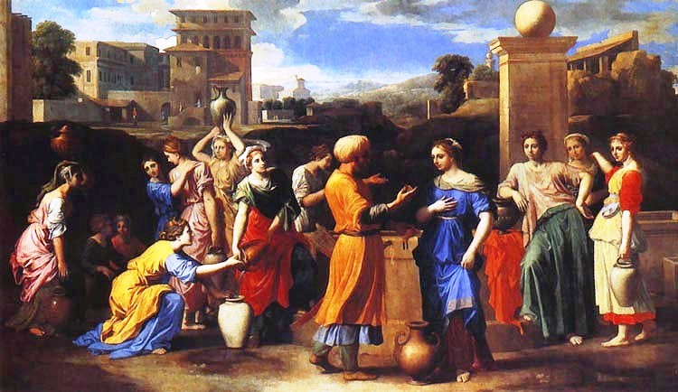
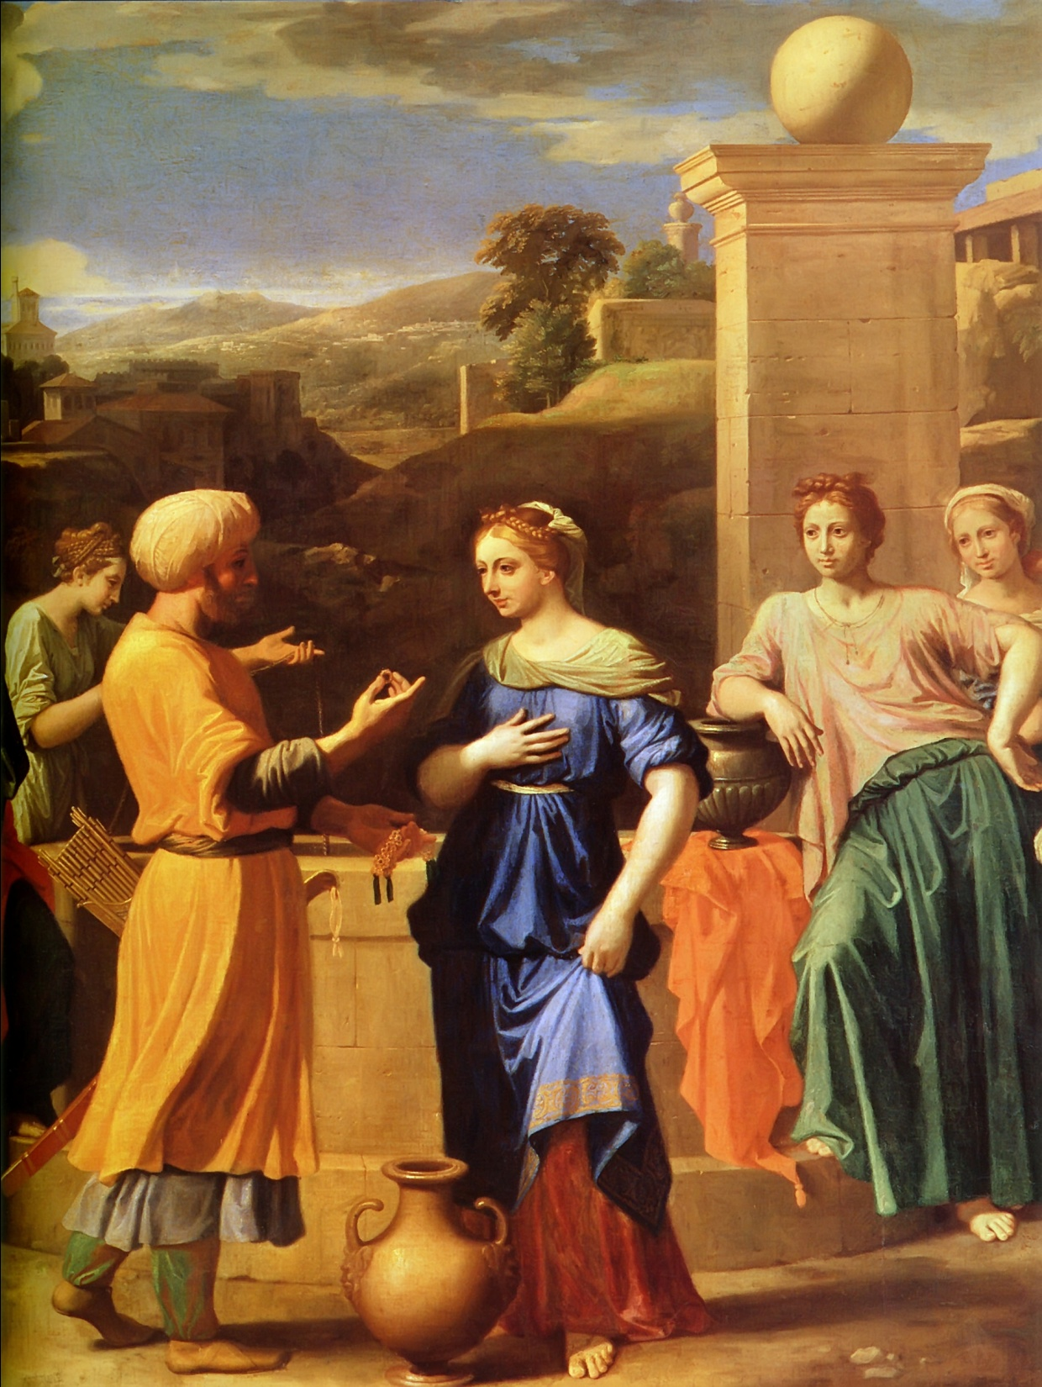
Nicolas Poussin:
'Eliezer and Rebecca at the Well
1648

Slide 31
Repeating storylines
Sibling Rivalry
Cain & Abel
Isaac & Ishmael
Jacob & Esau
Rachel & Leah
Joseph & brothers
Hidden Identities
Jacob & Isaac
Judah & Tamar
Joseph & brothers

Slide 32
Story cycles in Genesis
Primeval narratives: How the world got the way it is. A progression away from god-likeness to becoming human.
Abraham: Faithful. First man called by God to follow him. Abraham tested many times. (Moves to new land. Faithful to Lot. Circumcision. Binding of Isaac.) But not perfect.
Isaac: Passive. Not an agent, but an object. Sacrificed. Blind, on deathbed. Was he permanently disabled by sacrifice experience? Did his wife dominate him?
Jacob/Israel: Assertive and clever. Home – away – home pattern. Moves from having little to great abundance. Begins the proliferation of the Israelites.
Joseph: A dreamer and interpreter of dreams. Used by God to save His people. Moves from being a pampered child to a ruler in Egypt.

Slide 33
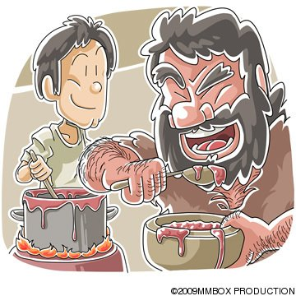
Compare the brothers Gen 25, 27-28
Jacob/Israel | Esau
Smooth Domestic Kitchen Loved by mother (Rebecca) Clever A trickster Aggressive Thinks long-term (Is his tricking bad, or is it God’s will?) Younger brother | Hairy Outdoorsy The fields Loved by father Dull, straight-forward easily tricked Passive Thinks with his stomach (Does he deserves to be tricked or is he a victim?) Older brother

Slide 34
Jacob (Gen 25-36)
Born holding Esau’s heel
Tricks Esau out of birthright
Steals Esau’s blessing
Runs away (for his life) to his Uncle Laban
Jacob’s Ladder dream (a theophany = sees God/Angel) at Bethel
Gets tricked by Laban (Leah vs. Rachel)
Prospers
Herds of goats (tricks Laban back)
12 children born in Haran (Mesopotamia) 11 boys, 1 girl.

Slide 35
Jacob, continued
Tricks Laban back and then must flee again.
Runs away, back to Canaan
Another theophany (wrestles with God/Angel) name changed to Israel
Reunites with Esau (Esau forgives)
Jacob visits the sites of the two theophanies, offers sacrifices, and god appears again and changes his name.
Jacob-Israel shows the struggle between God and man, especially between God and the Israelites.
Relationship with God is a struggle, but also there is blessing.
Jacob moves to the background, but takes center stage again at the end of Genesis when he blesses his children.

Slide 36
Children of Jacob/Israel
Leah | (Leah’s maid) Zilpah | Rachel | (Rachel’s maid) Bilhah
Reuben Simeon Levi Judah Issachar Zebulun Dinah | Gad Asher | Joseph Benjamin (the two youngest) | Dan Naphtali

Slide 37
Dinah
The one daughter of Jacob, she seems to be a liability.
There is a danger that Israel’s children could be lured into intermarrying and then they would die out as a people.
Simeon and Levi make sure that does not happen. (Gen 34)

Slide 38
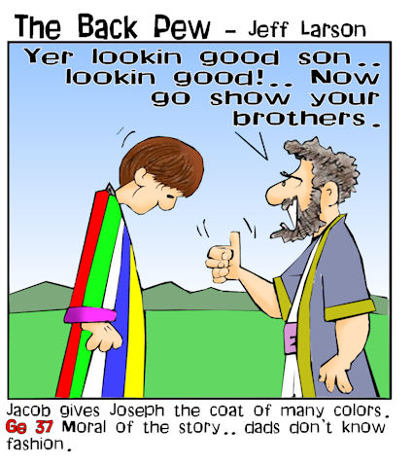
Joseph (Gen 37-50)
Another youngest son (almost).
Parental favoritism
doesn’t displease God
causes problems that advance the plot.
Nation of Israel grows through much political/human struggle and flawed people.

Slide 39
Joseph
He starts as a young, pampered dreamer, despised by his brothers
Joseph sold (father fooled, like he fooled his father).
Joseph in Potiphar’s House (women are dangerous)
Joseph in prison
Baker’s dream
Cupbearer’s dream
Joseph Interprets Pharaoh’s Dream and rises to power
Joseph sent by God to prepare the way for his family.
They muddle through family business and old grievances.
Jacob reveals himself. One of the most exciting stories in the Bible.
They settle in Goshen
Last Days of Jacob, he blesses his sons
Brothers still worried about Joseph, but he forgives.
Notice reoccurring themes, symbols, and plot elements in the patriarchal stories.

Slide 40
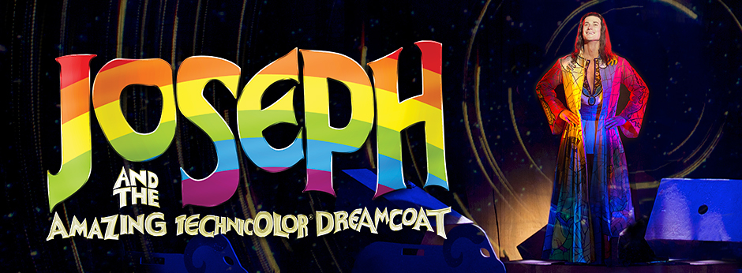
Lyrics by Tim Rice and music by Andrew Lloyd Webber. Based on the story of Joseph from the Bible's Book of Genesis, this was the first Lloyd Webber and Rice musical to be performed publicly.

