Slide 1
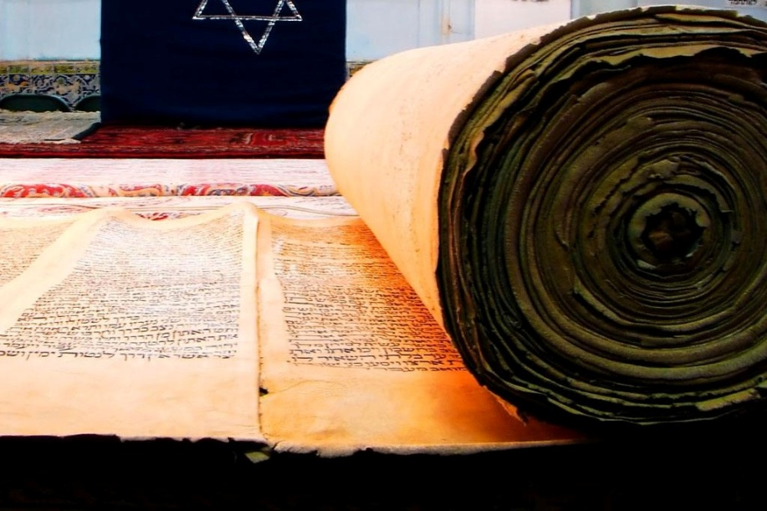
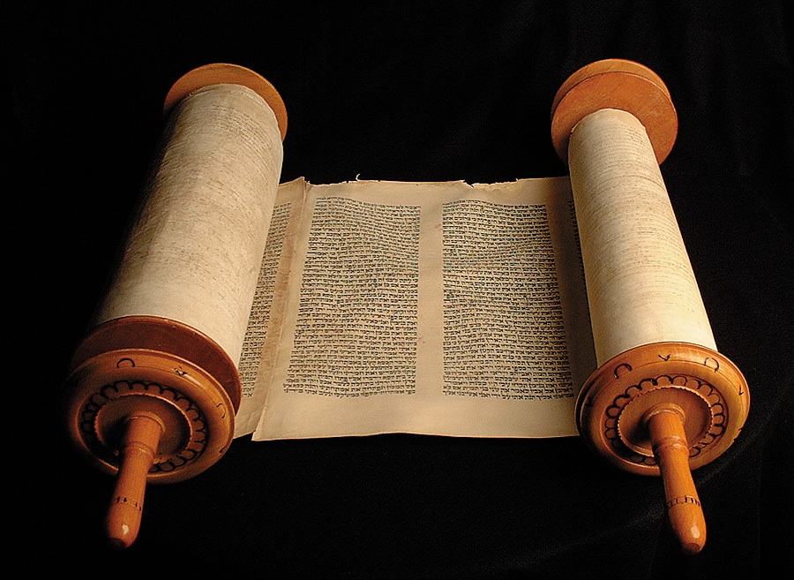
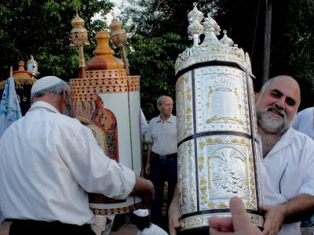
1 & 2 Samuel
Scrolls from the Hebrew Bible. Samuel is too big for one scroll.

Slide 2
5 sections of 1 & 2 Samuel The Rise of the Kingdom of Israel
Reading 1 Samuel 15-17: Saul rejected as king, David & Goliath for Today: 2 Samuel 1: David Mourns Saul and Jonathan’s deaths
5-7: David becomes king of ALL Israel
11-12: David & Bathsheba 1 Kings 1-3: Solomon becomes king
The story of Samuel (1 Sam 1:1-7:17)
Starting of kingship in Israel (Saul) (1 Sam 8:1-15:34)
David’s rise to power (1 Sam 15:34-2 Sam 5:10)
Events from David’s reign (2 Sam 5:11-12:31)
Absalom’s unsuccessful revolt against David, his father. (2 Sam 13:1-20:22)
Assortment of poetry, lists of officers, and general stories. (2 Sam 20:23-24:25)

Slide 3
The story of Samuel (1 Sam 1:1-7:17)
A transition between the period of judges and period of monarchy
Special birth (Nazarite dedicated to God from birth)
Barren old parents only child (mother: Hannah)
Apprentice of Eli
Samuel is a divinely appointed prophet
A priest, seer, war leader, judge.
Rejection of priestly house of Eli.

Slide 4
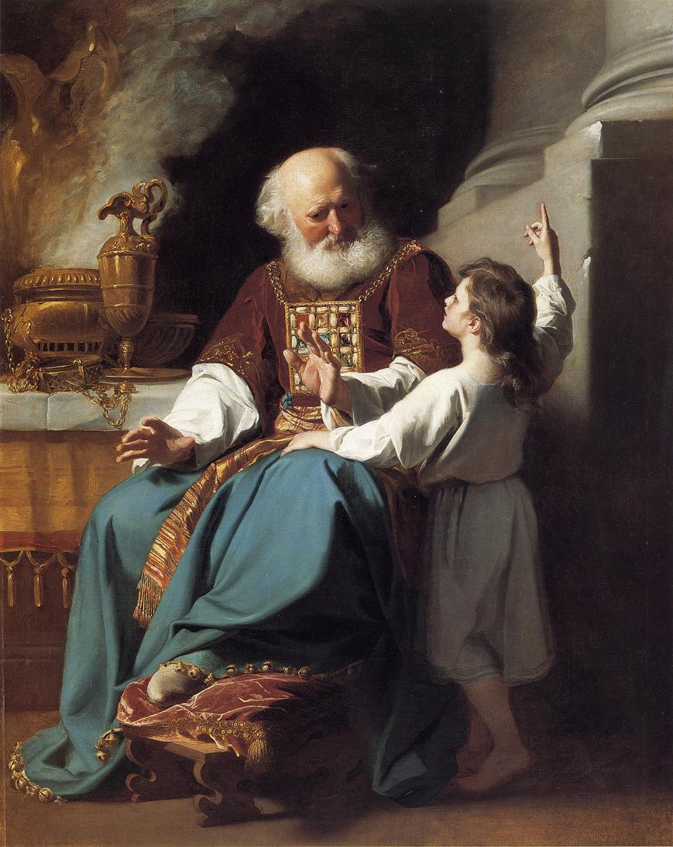
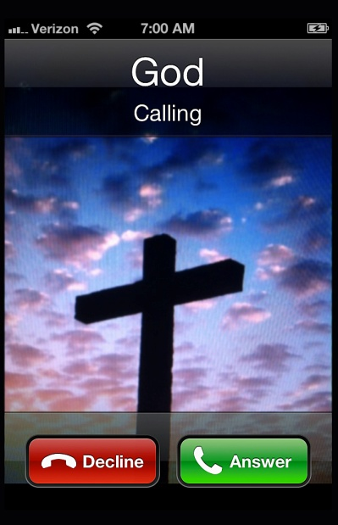
Speak, Lord, for
your servant is
listening.
(1 Sam 3.9)

Slide 5
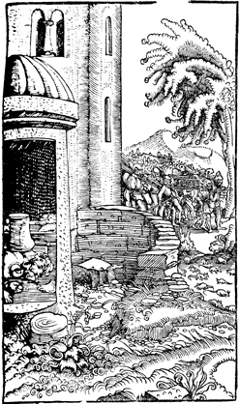
Ark Narrative (1 Sam 4:1-7:1)
Ark is captured by Philistines
Shows God’s anger at corrupt priesthood
Allowed God to afflict Philistines with a plague
Ark is returned voluntarily
God’s power, not man’s work.
Saul emerges as prominent priest
From a Reformation era Bible Circa 1500s

Slide 6
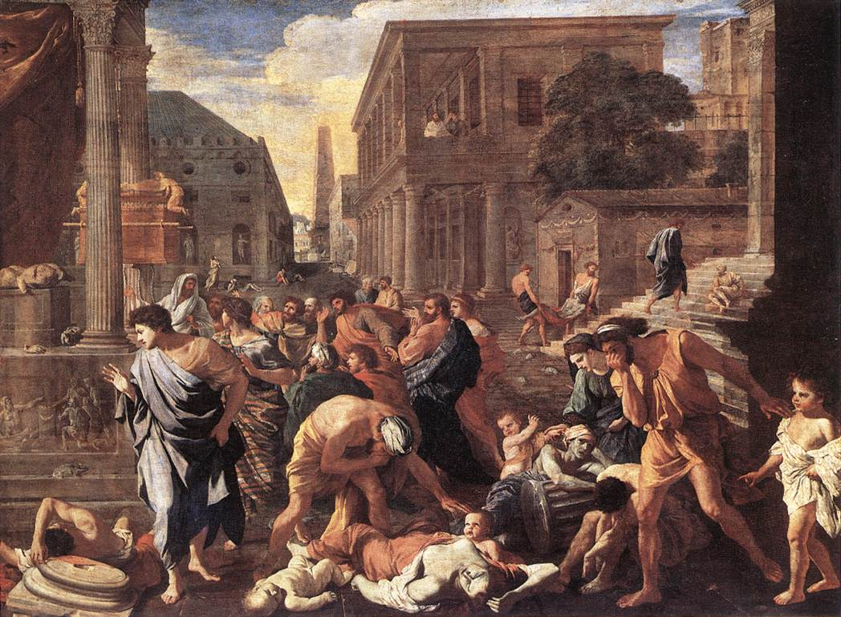
Nicolas Poussin (1594-1665) The Plague of Ashdod
Oil on canvas Louvre (France)

Slide 7
Beginning of Kingship (1 Sam 8:1-15:34)
Jonathan
The people demand a king and God consents (1 Sam 8)
Saul is chosen and anointed by Samuel (9-10)
9:2 “a handsome young man. There was not a man among the people of Israel more handsome than he; he stood head and shoulders above every one else.”
Saul leads liberates Jabesh-gilead (11)
Philistine wars (12-13)
defeats the Philistines (14)

Slide 8
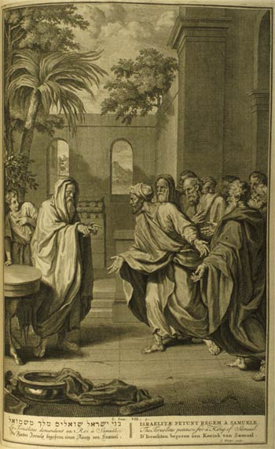
The people want a king!
1 Samuel 8:4-9: 4 Then all the elders of Israel gathered together and came to Samuel at Ramah, ⁵and said to him, ‘You are old and your sons do not follow in your ways; appoint for us, then, a king to govern us, like other nations.’ ⁶But the thing displeased Samuel when they said, ‘Give us a king to govern us.’ Samuel prayed to the Lord, ⁷and the Lord said to Samuel, ‘Listen to the voice of the people in all that they say to you; for they have not rejected you, but they have rejected me from being king over them. ⁸Just as they have done to me, from the day I brought them up out of Egypt to this day, forsaking me and serving other gods, so also they are doing to you. ⁹Now then, listen to their voice; only—you shall solemnly warn them, and show them the ways of the king who shall reign over them.’

Slide 9
Warning! (1 Sam 8)
¹¹He said, ‘These will be the ways of the king who will reign over you:
he will take your sons and appoint them to his chariots and to be his horsemen, and to run before his chariots;
¹²and he will appoint for himself commanders of thousands and commanders of fifties, and some to plough his ground and to reap his harvest, and to make his implements of war and the equipment of his chariots.
¹³He will take your daughters to be perfumers and cooks and bakers.
¹⁴He will take the best of your fields and vineyards and olive orchards and give them to his courtiers.
¹⁵He will take one-tenth of your grain and of your vineyards and give it to his officers and his courtiers.
¹⁶He will take your male and female slaves, and the best of your cattle and donkeys, and put them to his work. ¹⁷
He will take one-tenth of your flocks, and you shall be his slaves. ¹⁸And in that day you will cry out because of your king, whom you have chosen for yourselves; but the Lord will not answer you in that day.’
19 But the people refused to listen to the voice of Samuel; they said, ‘No! but we are determined to have a king over us, ²⁰so that we also may be like other nations, and that our king may govern us and go out before us and fight our battles.’

Slide 10
The people get their wish (those fools)
Chapter 10
17 Samuel summoned the people to the Lord at Mizpah ¹⁸and said to them, ‘Thus says the Lord, the God of Israel, “I brought up Israel out of Egypt, and I rescued you from the hand of the Egyptians and from the hand of all the kingdoms that were oppressing you.” ¹⁹But today you have rejected your God, who saves you from all your calamities and your distresses; and you have said, “No! but set a king over us.” Now therefore present yourselves before the Lord by your tribes and by your clans.’

Slide 11
Saul becomes king
Chapter 10
20 Then Samuel brought all the tribes of Israel near, and the tribe of Benjamin was taken by lot. ²¹He brought the tribe of Benjamin near by its families, and the family of the Matrites was taken by lot. Finally he brought the family of the Matrites near man by man,* and Saul the son of Kish was taken by lot. But when they sought him, he could not be found. ²²So they inquired again of the Lord, ‘Did the man come here?’* and the Lord said, ‘See, he has hidden himself among the baggage.’ ²³Then they ran and brought him from there. When he took his stand among the people, he was head and shoulders taller than any of them. ²⁴Samuel said to all the people, ‘Do you see the one whom the Lord has chosen? There is no one like him among all the people.’ And all the people shouted, ‘Long live the king!’

Slide 12
The message Reinforced (In the context of the Deuteronomic Covenant)
Chapter 12
¹³See, here is the king whom you have chosen, for whom you have asked; see, the Lord has set a king over you. ¹⁴If you will fear the Lord and serve him and heed his voice and not rebel against the commandment of the Lord, and if both you and the king who reigns over you will follow the Lord your God, it will be well; ¹⁵but if you will not heed the voice of the Lord, but rebel against the commandment of the Lord, then the hand of the Lord will be against you and your king. ¹⁶Now therefore take your stand and see this great thing that the Lord will do before your eyes. ¹⁷Is it not the wheat harvest today? I will call upon the Lord, that he may send thunder and rain; and you shall know and see that the wickedness that you have done in the sight of the Lord is great in demanding a king for yourselves.’ ¹⁸So Samuel called upon the Lord, and the Lord sent thunder and rain that day; and all the people greatly feared the Lord and Samuel.

Slide 13
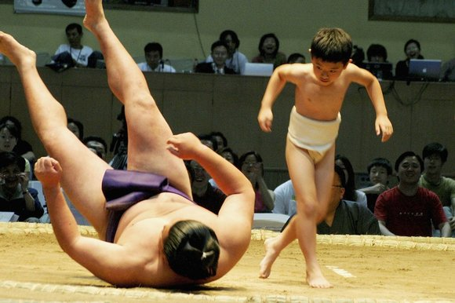
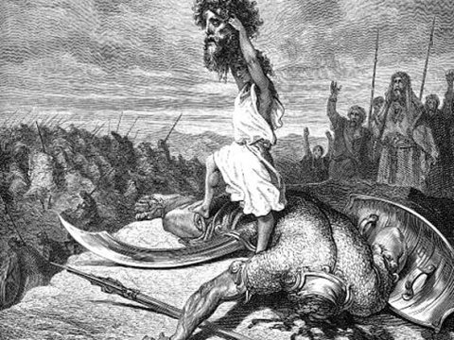
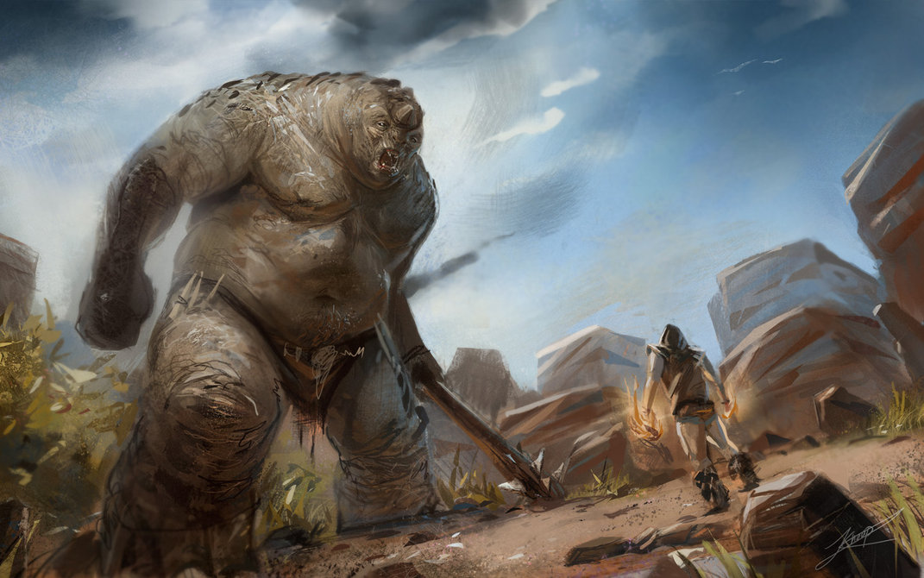

Slide 14
United Kingdom
BCE | Kings | Prophets
1050 | Saul: (he starts great, but is rejected by God) Son, Jonathan, is David’s friend, daughter Michal becomes David’s wife. | Samuel
1010 | David: The greatest king of Israel. Wins the most territory. “A man after God’s own heart.” Wrote many of the Psalms. Sinned but repented. | Nathan
970 | Solomon: Completed the temple. Peaceful kingdom. Known for wealth and wisdom.

Slide 15
The United Kingdom at its height

Slide 16
Kings of Israel (North), and Judah (South) after Solomon
BCE | Kings of Judah | Kings of Israel | Prophets
 | 1. Rehoboam | 1. Jeroboam
900 | 2. Abijah | 2. Nadab
 | 3. Asa | 3. Baasha
 |  | 4. Elah
 |  | 5. Zimri
 | 4. Jehoshaphat | 6. Omri
 |  | 7. Ahab (the worst) | (Elijah Israel)
850 | 5. Jehoram | 8. Ahaziah | (Elisha Israel)
 | 6. Ahaziah | 9. Joram | Joel Judah (maybe)
 | 7. Queen Athaliah |  | Jonah (to Nineveh) (approx)
800 | 8. Joash | 10. Jehu (OK, but still not great) | Amos Israel,
 |  | 11. Jehoahaz | Hosea Israel
 | 9. Amaziah | 12. Jehoash | Isaiah Judah (until Hezekiah)
 | 10. Uzziah (Azariah) | 13. Jeroboam II
750 | 11. Jotham | 14. Zechariah | Micah Judah (until Hezekiah)
 | 12. Ahaz | 15. Shallum, 16. Menahem
 |  | 17. Pekahiah, 18. Pekah, 19. Hoshea
725 | 13. HEZEKIAH (Best) | 722 fall of Samaria to the Assyrians
 | 14. Manasseh |  | Nahum (to Nineveh) (approx)
650 | 15. Amon |  | Jeremiah Zephaniah, (exile)
 | 16. JOSIAH (Best)
 | 17. Jehoahaz |  | Habakkuk (approx)
600 | 18. Jehoiakim |  | Ezekiel, Daniel
 | 19. Jehoiachin |  | Obadiah (to Edom)
 | 20. Zedekiah |  | Haggai, Zechariah
 | 587 Fall of Jerusalem to Babylonians | (Esther) (Ezra) (Nehemiah) | Malachi

